Slide 1
MBSE Workshop
Moderator:
Mark Williams, The Boeing Company

Slide 2
Workshop Agenda
Intro and Workshop History
Mark Sampson - MBSE Industry Maturity
Capability Assessment Criteria (define MBSE)
Develop an Industry Scorecard and Rating
Teams: Rating your Company
Peter Bilello - PLM Features affecting a PLM Capability Assessment
Teams: Prioritizing Gaps and Strengths, Industry and Company
Gaps and Strengths - Teams Report-out
Workshop Survey
15
60
10
20
30
20
40
10
10
10
Break

Slide 3
Workshop Exercise Agenda
Capability Assessment Criteria (define MBSE)
Develop an Industry Scorecard and Rating
Teams: Rating your Company
Teams: Prioritizing Gaps and Strengths, Industry and Company Internal and external design collaboration Support for interoperability
Gaps and Strengths - Teams Report-out

Slide 4
MBSE Workshop History
2014 - The first Systems Engineering Track for MBSE
The impact on PLM, Contributions/Suggestions from Multiple Industries
2015 - The first MBSE Workshop - OEM to Supplier Interoperability
Prioritized Industry Data Standards: SysML, OSLC, FMI, ReqIF
2016 MBSE Workshop - the Roadmap outline
Implementation issues - where/how to start, the role of the PLM Vendors
2017 MBSE Workshop - Gaps in the Roadmap
Interoperability Issues, the need for Leadership
2018 Improving/Integrating our Models with meta-data
The State of the Industry, opportunities, update our Roadmap, upgrade a Bicycle
2019 Managing Supplier Requirements
Evaluate a collaboration space and create a procurement specification for a box

Slide 5
2015 to 2018 Workshop: Industry Roadmap
2015
2016
2017
2018
2019
System Architecture
System Modeling
Requirements Mgmt
Data Management
Standards
Analysis, Simulation
Ontology, Semantics
Process
Skills
Organizations
Tools
Exchange Services
Exchange (OEM to Suppliers)
No Information Data Models
UAF and PKF
Requirement Models
Limited Integration
PLM Market
Limited Vendor Support
FMI & SSP
Modelica and FMI Export
RDF & OWL
First OSLC Implementations
Phoenix Integration, SpecInnovations, DSpace, InterCAX, Maplesoft, Sodius, ANSYS, IBM, CORE
Home Grown
Few Trained Modelers
College Curriculum
Integration Issue
Weak
Ready Today
Dedicated MBSE vs SE
50+ Vendor Brands

Slide 6
Data from 2017 GPDIS Workshop: Industry Roadmap

Slide 7
Common MBSE Modeling Domains and Associated Standards
Modeling
Data Package
Company Data Model
MARTE
AADL
MIL-STD-31000
FMI/FMU
XMI
SysML
MoSSEC
ReqIF
AP232
AP210
OPM
Execution/Translation
Company Business Model
UAF
AP242
Communication
Analysis Simulation
AP239
SysPhS
AP233
AP243
OSLC
Modelica
OWL Ontology
FMI/SSP
Standard Body Legend
Company
OMG
OASIS
W3C
ISO
SAE/other
CREDIT: Bill Chown, Mentor Graphics; MBSE Roundtable, 2015 GPDIS

Slide 8
MBSE Data Interoperability Specifications
Static
Maturing/Implementing
Planning Evolving
2019
2021
2023
2025
ReqIF
PBR
SPARQL
ReqIFv2
Active Development
XMI
RDF Data Model
OSLC
OPM
OWL
PKF
UAF
ARCADIA
Future Needs
AADL
FACE
Marte
SysPhS
UML
SysML
SysMLv2
AP233
STEP 23x
Process Development
AP210
AP242
AP209
AP243
LOTAR Protocols
AP239
SOSA
Modelica
FMI
SSP
DCP
eFMI
AP232
NAS9300-500
NAS9300-520
NAS9300-5xx
MIL-STD-31000
STEP 23x
Requirements Management
Analysis and Simulation
Architecture Authoring
Integration and Linking
Partners
ISO
MODELICA
OMG
OASIS
W3C
other
PDES, LOTAR, AFNeT, prostep ivip, INCOSE, NASA, NAFEMS, AIA, ASD, SISO, Open Group
from PDES-LOTAR MBSE Conference, May 8th, 2019. Revised March, 2022
Reference ASD Radar Chart for detailed descriptions
© PDES Inc. 2019-2022 | All rights reserved
Notes:
June 2022: Proposals to consider: RAAML and ISO 15926. How to define the lines and arrows?
March 2022: added standards OPM and ARCADIA. Removed SysMLv3. Change RDF Ontology to RDF Data Model. Added “other” consortium.
Solid lines represent relationships defined by future or subsequent standards. Dotted lines represent future needs.
Dec 2021, added standards: eFMI, removed PMM, Process Development was MBSE Deployments, SysMLv2 and SysPhS to Active Development, NAS9300-500, -520 to Process Development
March 2021, added standards:
SOSA, Sensor Open Systems Architecture, managed by The Open Group :
FACE, Future Airborne Capability Environment, managed by OMG : Object Management Group
PBR/PMM, Property-based Requirements/Property Model Method, AVSI : Aerospace Vehicle Systems Institute
OPM, Object Process Methodology
ARCADIA, Architecture Analysis & Design Integrated Approach

Slide 9
MBSE Enablers
PDES, Inc. Model-Based
Sys Eng.
Standardization Days
A&D PLM Action Group
INCOSE – PDES MoU
2020
MBSE for PDES
INCOSE TIMLM
SmartSE
LOTAR for MBSE
and DEIX WGs
SE Handbook
January 28, 2018
Tool Integration - Model Lifecycle Management
Digital Engineering Information Exchange

Slide 10
Workshop Exercise
Capability Assessment Criteria (define MBSE specific)
Develop an Industry Scorecard and Rating
Teams: Rating your Company
Teams: Prioritizing Gaps and Strengths, Industry and Company Internal and external design collaboration Support for interoperability
Gaps and Strengths - Teams Report-out

Slide 11
Define MBSE - Model-based systems engineering
The formalized application of modeling to support system requirements, design, analysis, verification and validation activities beginning in the conceptual design phase and continuing throughout development and later life cycle phases. (INCOSE)
The design/product requirements integrated within an architecture, verified by analysis, and represented in digital models that are explicit, coherent, and consistent. (GPDIS 2017)
The practice of developing a set of related system models that help define, design, and document a system under development in an efficient way. (SAFe, © Scaled Agile, Inc.)

Slide 12
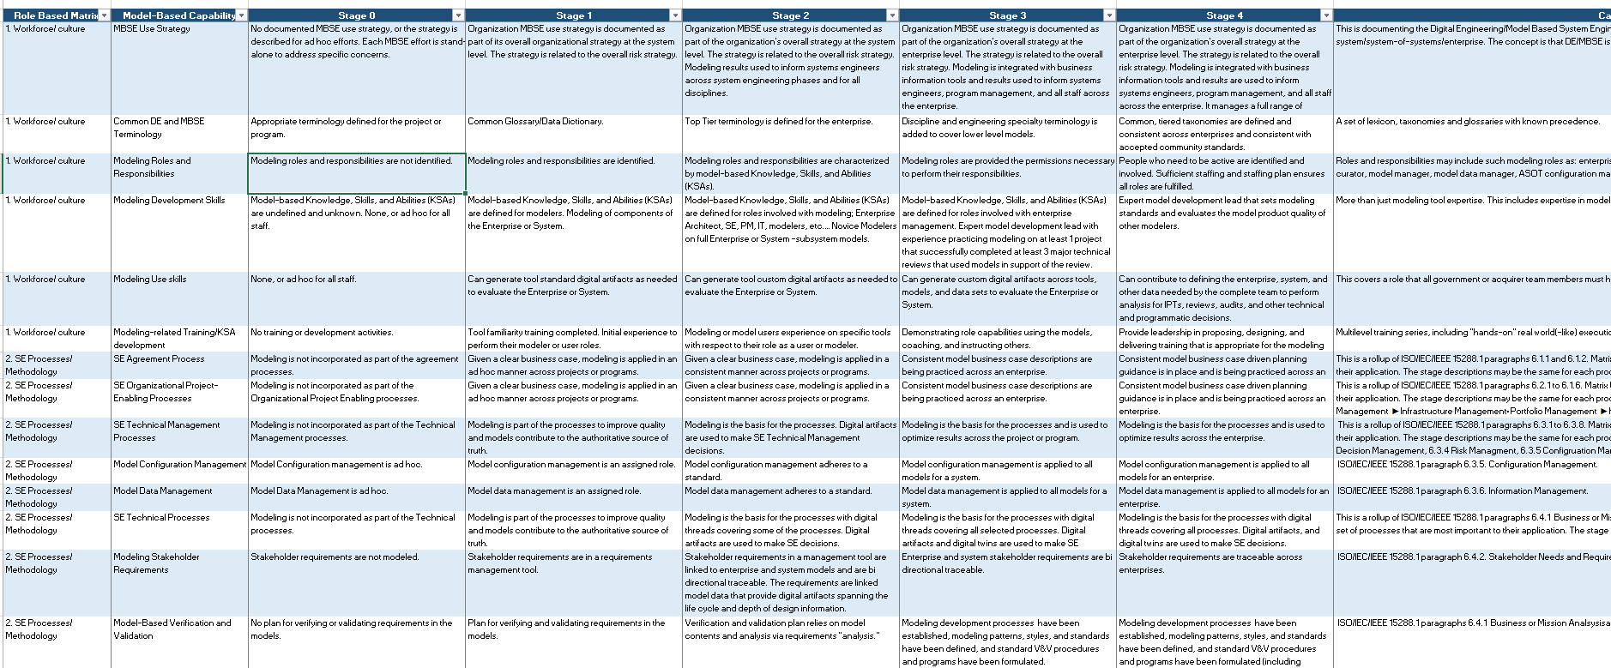
INCOSE Model-Based Capabilities Matrix-publication

Slide 13
Workshop Agenda – Group Exercise
Capability Assessment Criteria (define MBSE specific)
Develop an Industry Scorecard and Rating
Teams: Rating your Company
Teams: Prioritizing Gaps and Strengths, Industry and Company Internal and external design collaboration Support for interoperability
Gaps and Strengths - Teams Report-out

Slide 14
Rate the Industry
Use your perception and enter a minimum 3 scores per question (Aerospace, Automotive, General).
Scoring is 1-5 and 5 is highest score. Turn-in your score cards.
“other” if you want to add another industry (e.g. medical, ship building, etc.)
Define your View Point/Perspective: Industry, Company Role, Your role Tool Vendor, DE, Manager, IT, Program Mgmt, Supplier, OEM, academic, Consultant, other
Sample Questions:
Clearly identified, defined and useful MBSE data standards are used
Clearly defined orgs/consortiums/agencies are responsible for data standards
Integration tools (RDF Graph, LPG, visualization, SIM Labs, other)

Slide 15
Individual Scoring – 28 Viewpoints
2022 General Industry Score Card Summary
LOW Score | Medium Score | HIGH Score
6 | 15 | 7
Observations: Aero very slightly ahead of Automotive, Software ahead, Electronics behind

Slide 16
Workshop Agenda – Team Exercise
Capability Assessment Criteria (define MBSE specific)
Develop an Industry Scorecard and Rating
Teams: Rating your Company
Teams: Prioritizing Gaps and Strengths, Industry and Company Internal and external design collaboration Support for interoperability
Gaps and Strengths - Teams Report-out

Slide 17
Rate Your Company
Teams can be one company or a mix of companies. Preferably you rate your own company. However, you don’t need to reveal which company you are rating, if not your own. You define your score and explain your reasoning to the other team members. Justify criticism, praise or neutrality.
For the manager role and Industry IT, use your own viewpoint
If you are a tool supplier or solution provider, use the viewpoint of the products you sell or interface with
If you are ProjMan, academia, or consultant pick a familiar company to assess

Slide 18
Workshop Agenda – Teams Exercise
Capability Assessment Criteria (define MBSE specific)
Develop an Industry Scorecard and Rating
Teams: Rating your Company
Teams: Prioritizing Gaps and Strengths, Industry and Company
Gaps and Strengths - Teams Report-out

Slide 19
MBSE Capabilities Roadmap
Define a new Culture → Shift to a comprehensive advanced virtual engineering environment (NAFEMS SMSWG)
Vision 2030 and beyond…
Digital Twin
Digital Thread
Best Practices
Metadata Standards
Mapping OWL Ontologies
Data Standards Plan
Software Modeling
Data Reuse and Archiving
Engage Organizations
Work Instructions
Data Traceability -
Synchronization
Standards based Interoperability
Network Signaling
Identify Standard Tools
Behavior Modeling
Deploy Training
Data Linking
Modeling Frameworks and Work Flows
STRATEGY:
Process Architecture
PLM Strategy
Internal Collaboration
Allocate Requirements
Tools Available
PDM Strategy
Data Analytics
Multi-Domain Deployments
Management Endorsement
Manage Obsolescence (tools & data)
Functional -Logical Architecture
Enterprise Deployment
Supplier Collaboration
Terminology-Taxonomy
Config-Change Management
Grass Roots: Project Prototypes
Deployment Metrics
Design Authoring and Integration Technologies
Standardize Deployment
Goals
Safety, Data Assurance
Process – Tool Infrastructure
Identify / support emerging standards
Tool Vendor Requirements
Product Sustainability
2019 2020 2021 2022 2023 …beyond….
© PDES Inc. 2021-22 | All rights reserved
from PDES-LOTAR MBSE Teams to INCOSE, Jan 2021, updated March 2022
Notes:
June 2022 Proposals to consider: Remove, or revise the NAFEMS reference.
March 2022: Added Reuse to Data archiving, added OWL to Ontologies, added Work Flows to Frameworks, added Standards based Interoperability
December 2021: Added Config Mgmt. Revised colors and alignments. Added Product Sustainability and Goals.
The MBSE Capabilities Roadmap was developed by PDES MBSE with the help of INCOSE TIMLM Working Group and NAFEMS

Slide 20
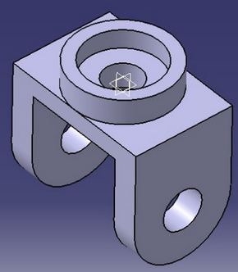
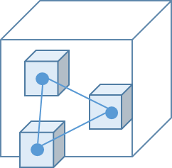
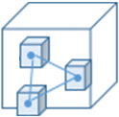
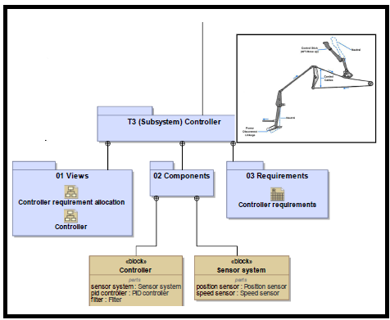
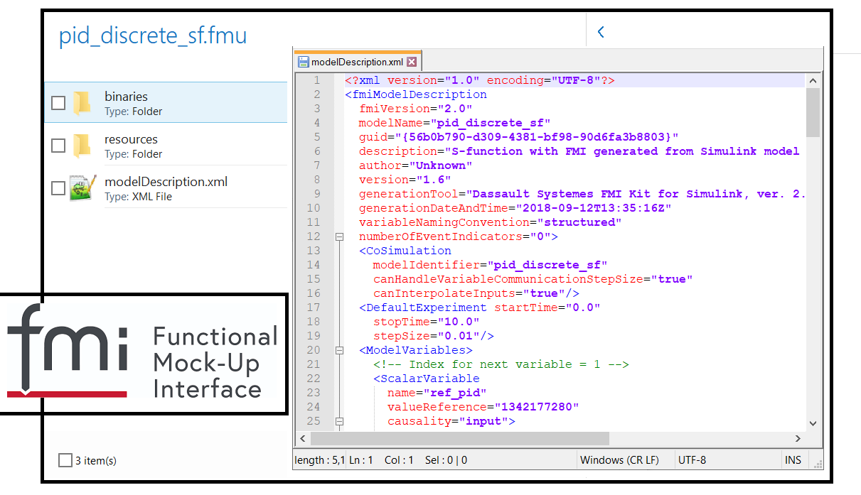
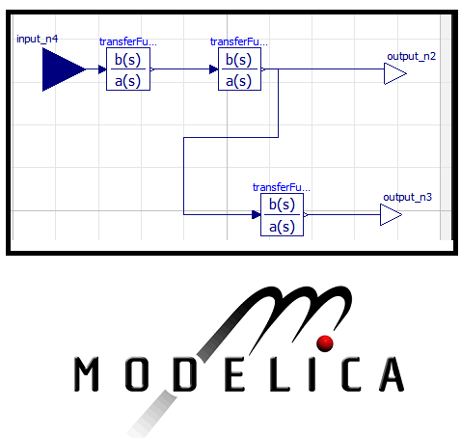
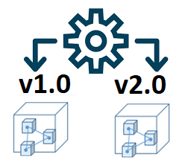
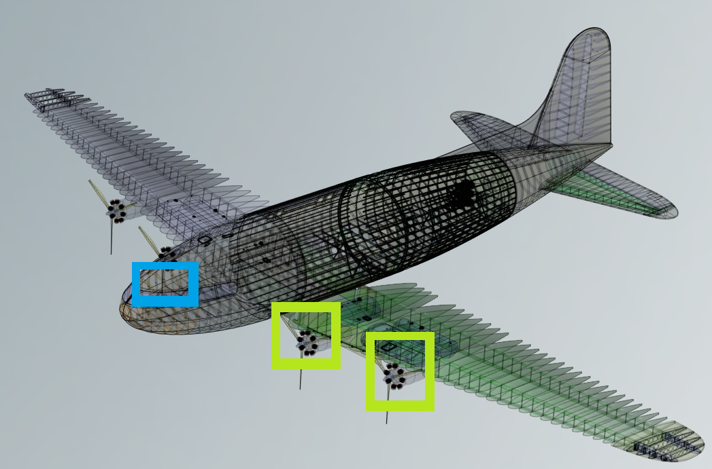
Supplier Engagement Framework
LEVEL 1
EXCHANGE
Unidirectional Exchange of TDP – build to model
Unidirectional exchange of Technical Data Packages (TDP) from OEM to Supplier. Supplier feedback will be requested and may contain model artifacts.
LEVEL 2
INTEROPERABILITY
Bidirectional Exchange of TDP – build to requirements
Bi-directional exchange of TDP. OEM provides specification models. OEM and supplier import, review and return different versions of the TDP.
Digital TDP
Digital TDP
Manifest
Supplier
Supplier
OEM
OEM
Supplier Feedback incl. Quality data
Digital TDP
LEVEL 3A
COLLABORATION based on TDP
Co-development where OEM and supplier import, review and return a shared version of the TDP, under common Configuration Management (CM).
LEVEL 4
DIGITAL INTEGRATION
Platform level co-simulation
Joint simulation of behavior (executable) models to perform system or platform level integration tests. Used in combination with other Engagement Levels. Multiple variants: real time, distributed, cloud based…
Common Config Mgmt.
Digital TDP
Integrated Digital Environment
OEM
Supplier
System A Supplier
LEVEL 3B
COLLABORATION based on PLM
Co-development in a shared “collaboration vault” where TDP content is managed. Common, PLM-enforced data Configuration Management is required.
OEM
Supplier A System model
Technical Data
Sim Platform
System B Supplier
Supplier B System model
OEM
Collaboration
Hub
Supplier
RROI 22-174038

Slide 21
Build an Advanced MBSE Capability Assessment
Clean Sheet, using the Industry and Company assessments, what MBSE capabilities are needed for the future?
Six Teams. Each Team member contributes at least one idea. The Team collective prioritizes the list. Select one spokesperson and report back to Group.
Supplier Engagement Process - Internal and external design collaboration, and built-in support for interoperability
V&V and Safety models using specialized architecture and modeling tools
Alternative data representations
Stable IT Infrastructure for repositories and web services
Resource planning and training
How to better capitalize on investments and skills
Team Responses

Slide 22
Survey Questions: Tool and Process
Your Opinion: What is the overall best, or most promising MBSE capability available in the Industry?
What is the best, or most promising MBSE capability available in your company, industry, business?
What is the most important MBSE capability generally missing across the industry?
What is the most important MBSE capability missing in your company’s portfolio?
Was this workshop useful?
What should be the content of next year’s workshop?

Slide 23
Survey Questions (28 participants responded)
Provide two answers for each question: Tool and Process
 | Tools | Process
1 | Model/data integration, req models, simulations, industry collab, SysML-V2, Vendor diversity | Requirements to architecture comes first
2 | Model Exchange-data integration, simulations, graphDB/linked data, ChgMan, requirements verification | Requirements2functions2architecture
3 | DigThread, interoperability, standards, supplier exchange, data integration, metadata management | Best practices, MBSE in PLM
4 | Best practices, MBSE in PLM, training, ChgMan, ChgNotification, standards, model’s purpose | Best practices, common process
5 | Yes, more aerospace focus, more time for team exchange
6 | Model integration techniques, Model interoperability examples, DigThread examples, SysPhyS, Measure model quality, generate linked data
Industry
Company
Industry
Company
Results reflect most frequent response

Slide 24
References
Search the Web: “MBSE Capability Assessment”
Towards a maturity assessment scale for the Systems Engineering assets valorization to facilitate Model-Based Systems Engineering adoption, INSIGHT - International Council on Systems Engineering (INCOSE), Wiley, 2019, 22 (4), pp.37-39. 10.1002/inst.12274: Wu, https://hal.archives-ouvertes.fr/hal-02438800, Submitted on 14 Jan 2020. An white paper providing an alternative method of measuring process capability
SE-CapabilityMaturityModel1995_008_001_16355.pdf A excellent description of the SE-CMM capability categories
A Maturity Model for the Deployment of Systems Engineering Processes
Survey content is derived from the draft INCOSE Digital Engineering Capabilities Definition
INCOSE MODEL-BASED CAPABILITIES MATRIX AND USER’S GUIDE
The INCOSE Model-Based Capabilities Matrix (MBCM)
The SERC \ NDIA MBSE Maturity Criteria, Scorecard, and Industry Assessment
SERC reports: SERC-2017-TR-110 , SERC-2019-TR-005
The Cross-Discipline Collaboration assessment from JAMA Software
CMMI MBSE Capability Assessment Overview , Mark Sampson, Siemens, INCOSE IW2022 MBSE Workshop
MBSE Benchmarking, Digital Engineering Benefits Study
Quentin Wu, David Gouyon, Sophie Boudau, Eric Levrat. Towards a maturity assessment scale for
the Systems Engineering assets valorization to facilitate Model-Based Systems Engineering adoption.
INSIGHT - International Council on Systems Engineering (INCOSE), Wiley, 2019, 22 (4), pp.37-39.
10.1002/inst.12274: Wu, https://hal.archives-ouvertes.fr/hal-02438800, Submitted on 14 Jan 2020

Slide 25
Industry Assessment (28 responses)
 | Grading scale is 1 to 5, 5 is best score |  | Industry General | Aerospace | Automotive | other
1 | Clearly identified, defined and useful MBSE data standards are generally used |  | 2.2 | 2.6 | 2.7 | 2.1
2 | Clearly identified orgs/consortiums/agencies are responsible for data standards |  | 2.9 | 3.3 | 3.2 | 2.6
3 | Clearly identified, defined and useful MBSE process standards |  | 2.4 | 2.3 | 2.4 | 2.1
4 | Clearly identified orgs/consortiums/agencies responsible for process standards |  | 2.5 | 2.9 | 2.8 | 2.4
5 | Highly functional and integrated tools for Enterprise and small companies |  | 2.3 | 2.7 | 2.4 | 2.4
6 | Proprietary tools that deliver industry leading mature capabilities |  | 2.9 | 3.2 | 3.3 | 2.4
7 | Open source tools that deliver industry leading mature capabilities |  | 2.4 | 2.4 | 2.5 | 2.3
8 | MBSE capabilities for specific Domains are easy to distinguish and adopt (structure, fluids, electrical systems, electronics, mech systems, software, other) |  | 1.9 | 2.3 | 1.9 | 1.7
9 | OEM and Suppliers have the same needs and can both utilize the same MBSE capabilities |  | 2 | 2.2 | 2.3 | 1.6
10 | Enterprise PLM tool suites have the majority of MBSE capabilities needed for implementation |  | 1.9 | 2.2 | 2.2 | 1.7
11 | Training is readily available from community colleges, universities, other sources |  | 1.8 | 2 | 1.9 | 1.7
12 | Specialized add-on tools, frameworks, aids, grammars are available to guide the process |  | 2.2 | 2.4 | 2.6 | 1.9
13 | A clear migration from historical documentation deliverables to cohesive integrated models |  | 1.6 | 2 | 2.3 | 1.7
14 | The MBSE Resources and environments needed for Supplier Collaboration are readily available |  | 1.4 | 1.9 | 2.2 | 2.9
15 | Data integration tools (RDF Graph, LPG, visualization, web services, other) are standard practices |  | 1.7 | 2 | 2.1 | 2.1
16 | The format for my Technical Digital Data Package is understood and easily implemented |  | 1.8 | 2.1 | 2.2 | 1.6
 | User Identification: What Industry ? |  | Company’s Role | Your Title/Role

Slide 26
Company Assessment
 | Grading scale is 1 to 5, 5 is best score | Score | Comments
1 | There is a dedicated organization managing the MBSE tools and deployments | 3.08 | New organization
2 | The company Executives support MBSE and its implementation. | 3.2 | Some Management
3 | There is a common Enterprise tool suite used for all new programs and products | 2.84 | Enterprise Tool initiative
4 | There is Company sponsored specific training available for all MBSE tools. | 2.84 | Mixed Training
5 | There is Company sponsored best practices and process training for MBSE models | 2.76 | limited Process Training
6 | Each new program or product uses MBSE as the baseline | 2.4 | All large Products
7 | Model exchange is common and Documentation is only used when needed | 2.28 | Limited Model Exchange
8 | We have a design for our digital thread and all of the models are connected | 2.04 | Integrated Digital Thread (DTh)
9 | Data management includes both model change control, configuration, and maturity states | 2.72 | Need more Change Management
10 | The Data management repositories are designed for the different model types | 2.4 | Share point
11 | There are model quality standards and checks that are used for all shared models | 2.32 | Mixed Quality
12 | We capture model metadata in our repositories, or in a model manifest | 2.32 | limited Metadata
13 | We use a Supplier Collaboration Environment and have Supplier guidelines | 2.56 | Specific Suppliers
14 | We consume/host Supplier data into our repositories and integration process | 2.44 | Mostly CAD
15 | We have internal initiatives supporting the development of data and process standards | 3.6 | MBSE Standards under Development
16 | The MBD skills may be another organization but maturity states account for their integration | 2.12 | limited process control
17 | Integration tools (RDF Graph, LPG, queries, analytics) satisfy or supplement the process | 2.24 | Select departments

Slide 27
Survey Results - Workshop Participant Responses

